Slide 1
Recommendations to derive quality standards for chemical pollutants in reclaimed water intended for reuse in agricultural irrigation
Qu’est-ce que DERAC
Geneviève Deviller, Lian Lundy, Despo Fatta-Kassinos
SETAC SciCo
Session 4.15 – Wastewater and Sludge Reuse in Circular Economy
Wednesday 6 May 2020

Slide 2
Context
Global water scarcity
Agricultural irrigation is the major use of water
Water reused in EU without harmonised rules
EC proposal for a regulation on Minimum Quality Requirements for reclaimed water reuse (2018)
EFSA and SCHEER opinion: the proposal provided insufficient protection to environmental and human health especially with regard to Compounds of Emerging Concern (CECs).

Slide 3
Methodology
Identification and prioritisation of chemical contaminants of concern
Sources of wastewater and EU policy landscape
Prioritisation of candidate substances
Methodological approach to derive chemical quality standards for RWAI
Identification of the environmental compartments and organisms at risk
Evaluation of the applicability of the EQS derivation methodology under the WFD
Data gaps, uncertainties and research needs
Transformation products, unregulated substances, data on terrestrial ecosystems
NORMAN Working group on ‘Water reuse and policy support’
Notes:
This slide presents an overview of the approach taken - bullets are the steps I’ll talk through in the following slides

Slide 4
Sources of wastewater and EU policy landscape
UWWTD (EEC, 1991)
Industrial Emissions Directive (EU, 2010)/ BAT for common wastewater and waste gas treatment/management systems in the chemical sector (2016)
European Pollutant Release and Transfer Register Regulation (EU, 2006)
WFD and the Priority Hazardous Substances Directive (EU, 2013)
Potentially all chemical categories can reach WWTPs and RWAI

Slide 5
Prioritisation of candidate substances (1)
Chemical category | EU legislation | EU implementing authority
Industrial chemicals | REACH & CLP regulations | ECHA
Biocidal products | BPR & CLP regulations | ECHA
Human medicinal products | Medicinal products for human use Directive | EMA
Veterinary medicinal products | Veterinary medicinal products Directive | EMA
Plant protection products | PPP & CLP regulations | EFSA
Cosmetic products | Cosmetic products regulation | ECHA
Food and feed additives | Food additives regulation Feed additives regulation | EFSA
Other substances | POPs regulation | ECHA

Slide 6
Prioritisation of candidate substances (2)
ECHA SVHC roadmap (REACH/CLP)
Persistency, Bioaccumulation and Toxicity properties (PBT/vPvB)
Carcinogenicity, Mutagenicity, Repro-toxicity (CMR) cat 1A/1B
Endocrine disruption (ED)
Sensitisation
High tonnage for wide dispersive uses
Relevance of the prioritisation exercise for RWAI
Declassification criteria based on water treatments performance

Slide 7
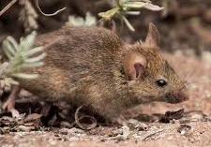
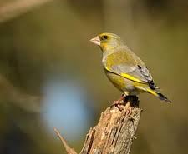
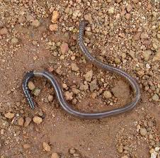
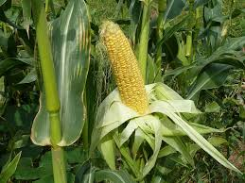
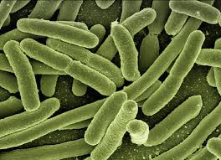
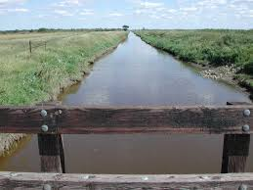
Identification of ecosystems and organisms at risk of exposure to reclaimed water for agricultural irrigation
Indirect exposure
Direct exposure

Slide 8
Evaluation of the applicability of the EQS derivation methodology under the WFD
Justified by the harmonisation of regulation concept and current practices.
EU technical guidance for deriving EQS (2018).
Further adaptation are needed to protect terrestrial organisms:
Directly exposed (e.g. bacteria, invertebrates, plants)
Predators and Top predators
Humans consuming crops and animal products
Available methodologies

Slide 9
Data gaps, uncertainties and research needs
Transformation products in WWTPs effluents
Unregulated substances: storm water runoff, illicit drugs, microplastics
Data on terrestrial ecosystems: persistance, bioaccumulation through the food chain and toxicity including endocrine disrupting effects.
Quality standards media conversion:
Biota concentration into soil concentration using BSAF and BMF
Soil concentration into RWAI concentration using model (e.g. sludge)

Slide 10
Key messages
Current legislation is insufficient to manage the risk posed by CECs in RWAI.
Prioritisation rules from regulators are useful to identify substances of concern.
EQS developed under the WFD are not enough to protect all exposed organisms by RWAI.
New EQS to protect the terrestrial compartment and their consumers are proposed.
Data gaps exist on soil ecosystem, WWTP removal efficiencies and degradation products.

Slide 11
NORMAN network ‘water reuse and policy support ’ working group
Activities:
Set a priority list of CECs (incl. ARB/ARG) based on monitoring results and prioritisation schemes at EU regulatory level.
Assess degradation for prioritized CECs in WWTPs and develop efficient technologies.
Develop the methodology to set quality standards for CECs in reuse water/sludge:
Develop exposure scenarios for reuse water in order to allow a proper risk management.
Opportunity to participate in an international survey of SARS-CoV-2 in sewage using a common sampling and analysis protocol
We are asking any expert in the field willing to join the NORMAN network to express their interest! The planned satellite meeting at this EU SETAC congress has been cancelled and will be replace by a virtual meeting mid-June.

Slide 12
Thank you for your attention!
Interaction between presenters and participants will be enabled during the meeting session discussion on Wednesday 6 May 2020, 13:45-14:30 UTC.
You can also leave your question in the Q&A chat box and we will answer to you ASAP

